Slide 1
KURSUS JURULATIH UTAMA KURIKULUM STANDARD SEKOLAH RENDAH( KSSR ) 2011
BAHASA INGGERIS-TAHUN 2

Slide 2
KBSR ENGLISH 2001
Social skills
Educational Emphases
Multiple Intelligences
Thinking Skills
Contextualism
Constructivism
World of self
Listening
World of stories
Grammar Sound System Vocabulary
Writing
Speaking
Reading
IT skills
Values and Citizenship
World of knowledge

Slide 3
NEW CURRICULUM MATRIX
 | STRAND 1 | STRAND 2
 | Language Focus | Language Arts
LEVEL 2 (YEARS 4, 5 & 6) | Skills – Listening & Speaking, Reading and Writing Vocabulary (includes Science & Maths themes as well as Grammar ) | Readers + (Literature) English at Play: Music, Poetry & Drama
LEVEL 1 (YEARS 1,2 & 3) | Skills – Listening & Speaking, Reading and Writing Vocabulary Grammar (Year 3) (phonics & penmanship) | Readers - Big Books Lady Bird Series Music, Poetry & Drama
Pre-school
PRIMARY

Slide 4
PRESENT & FUTURE
KBSR
KSSR
1. CURRICULUM DOCUMENTATION
SYLLABUS
STANDARD DOCUMENT
CONTENT STANDARDS
&
LEARNING STANDARDS
CURRICULUM SPECIFICATIONS
TEACHER’S GUIDE

Slide 5
PRESENT & FUTURE
KBSR
KSSR
2. CURRICULUM ORGANISATION
LANGUAGE TAUGHT THROUGH THREE BROAD AREAS
LANGUAGE TAUGHT THROUGH THREE BROAD AREAS
MODULAR STRUCTURE
INTEGRATION OF SKILLS
INTEGRATION OF SKILLS

Slide 6
PRESENT & FUTURE
KBSR
KSSR
3. CURRICULUM CONTENT
FOCUS ON FOUR LANGUAGE SKILLS
FOCUS ON FOUR LANGUAGE SKILLS
SOUND SYSTEM
BASIC LITERACY
PHONICS
LANGUAGE ARTS
PENMANSHIP
GRAMMAR IN CONTEXT
GRAMMAR IN CONTEXT

Slide 7
PRESENT & FUTURE
KBSR
KSSR
4. APPROACH
WHOLE LANGUAGE
PHONICS
STANDARD BRITISH ENGLISH
5. ADDED VALUE
EDUCATIONAL EMPHASES
EDUCATIONAL EMPHASES
CREATIVITY & INNOVATION
ENTERPRENEURSHIP

Slide 8
DIFFERENCE BETWEEN SK & SJK
SEKOLAH KEBANGSAAN
300 minutes per week
for Level 1 & 2
Literacy in Years 1 & 2
(teaching of phonics)
Additional learning
standards have been
included.
SEKOLAH JENIS KEBANGSAAN
150 minutes per week for
Level 1 & 2
Literacy in Years 1, 2 & 3
(teaching of phonics)
Learning Standards are
spread throughout the 6
years in order to
prepare pupils for
secondary education.

Slide 9
PRINCIPLES
Back to basics
building a strong foundation of competencies in basic literacy skills; reading through phonics, penmanship, basic listening and speaking
Learning is fun, meaningful, purposeful
activities are contextualized, meaningful and purposeful; fun-filled activities
integration of skills
Teaching is learner-centred
learner’s needs and salient learner factors (environment, family, language use contexts, entry behaviour)

Slide 10
PRINCIPLES
Integration of salient new technologies
use of ICT to facilitate and encourage meaningful language practice
creative and innovative use of the new technologies by pupils to enhance language learning in the classroom
Character-building infused
inculcating moral values in order to produce individuals who are articulate, confident, resourceful and of good character

Slide 11
GENERAL AIMS
Primary ( exit after Year 6)
The English Language Curriculum for Primary Schools aims to equip pupils with basic language skills to enable them to communicate effectively in a variety of contexts that’s appropriate to the pupils level of development.
Secondary (exit after Form 5)
Pupils will be able to communicate effectively, read and respond to texts independently, produce well-structured written texts, enjoy and respond to literary works and make confident presentations.

Slide 12
A MODULAR APPROACH
LISTENING AND SPEAKING MODULE
READING MODULE
WRITING MODULE
LANGUAGE ARTS MODULE
GRAMMAR MODULE
YEAR 1
YEAR 2
YEAR 3
YEAR 4
YEAR 5
YEAR 6
STAGE ONE
(YEARS 1 – 3)
STAGE TWO
(YEARS 4 – 6)

Slide 13
CONTENT CONFIGURATION
D1
D2
D3
D4
D5
World of Self
LISTENING & SPEAKING
READING
WRITING
GRAMMAR
LANGUAGE ARTS
World of Stories
World of Knowledge
World of Self
World of Stories
World of Knowledge
World of Self
World of Stories
World of Knowledge

Slide 14
WEEKLY LESSON STRUCTURE
WEEK | THEME/TOPIC | DAY ONE | DAY TWO | DAY THREE | DAY FOUR
 |  | LISTENING & SPEAKING | READING | WRITING | LANGUAGE ARTS
1 | WORLD OF SELF, FAMILY & FRIENDS E.g. F.R.I.E.N.D.S Pin-Up | 1.1.1 Able to listen and respond to stimulus given with guidance: (f) voice sounds 1.2.2 Able to listen to and follow: (a) simple instructions in the classroom | 2.2.1 Able to read and apply word recognition and word attack skills by: (b) reading and grouping words according to word families. 2.2.2 Able to read and understand phrases in linear and non-linear texts. | 3.2.1 Able to complete with guidance: (b) posters | 4.1.2 Able to sing action songs and recite jazz chants with correct pronunciation, rhythm and intonation.

Slide 15
SAMPLE LESSON STRUCTURE
Pre-listening
Listening to environmental sounds.
Talking about a stimulus.
Listen to rhymes/songs.
Listen to stories.
Repeat song or rhyme after the teacher.
While-listening
Recite or sing rhymes/songs.
Sequence pictures.
Match pictures with phrases.
Fill in the blanks with suitable words.
Post-listening

Slide 16
CONTENT AND LEARNING STANDARDS (Year 2 Sample)

Slide 17
LISTENING & SPEAKING
1.1 Pupils will be able to pronounce words and speak confidently with the
correct stress, rhythm and intonation.
1.1.1 Able to listen and respond to stimulus given with guidance:
(a) environmental sounds
(b) instrumental sounds
1.1.2 Able to listen to and enjoy simple stories.
1.1.4 Able to talk about a stimulus with guidance.
1.2 Pupils will be able to listen and respond appropriately in formal and
informal situations for a variety of purposes.
1.2.1 Able to participate in daily conversations:
(a) exchange greetings
(b) make polite requests

Slide 18
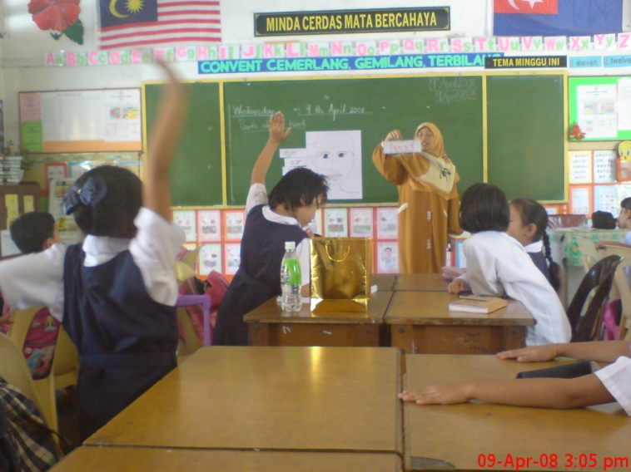
LISTENING & SPEAKING
1.3 Pupils will be able to understand and respond to oral texts in a
variety of contexts.
1.3.1 Able to listen to and demonstrate understanding of oral texts by:
(a) answering simple Wh-Questions
(b) giving true/false replies

Slide 19
READING
2.1 Pupils will be able to apply knowledge of sounds of letters to recognise
words in linear and non-linear texts.
2.1.1 Able to recognise and articulate initial, medial and the final sounds in
single syllable words within given context:
(a) /eɪ/ (ai ) /i:/ (ee) /aɪ/ (igh) /әʊ/ (oa) /ʊ/,/u:/ (oo)
2.1.2 Able to blend phonemes into recognisable words and read them
aloud.
2.1.3 Able to segment words into phonemes to spell.

Slide 20
READING
2.2 Pupils will be able to demonstrate understanding of a variety of linear and
non-linear texts in the form of print and non-print materials using a range of
strategies to construct meaning.
2.2.2 Able to read and understand phrases in linear and non-linear texts.
2.2.3 Able to read and understand simple sentences in linear and non-linear
texts.
2.2.4 Able to read and understand a paragraph of 5-8 simple sentences.
2.3 Pupils will be able to read independently for information and enjoyment.
2.3.1 Able to read simple texts with guidance:
(a) fiction
(b) non-fiction

Slide 21
WRITING
3.1 Pupils will be able to form letters and words in neat legible print including
cursive writing.
3.1.1 Able to write in neat legible print:
(a) words
(b) phrases
(c) simple sentences
3.1.2 Able to write numerals in neat legible print:
(a) numeral form
(b) word form
3.2 Pupils will be able to write using appropriate language, form and style for a
range of purposes.
3. 2.1 Able to complete with guidance:
(a) simple messages
(b) posters

Slide 22
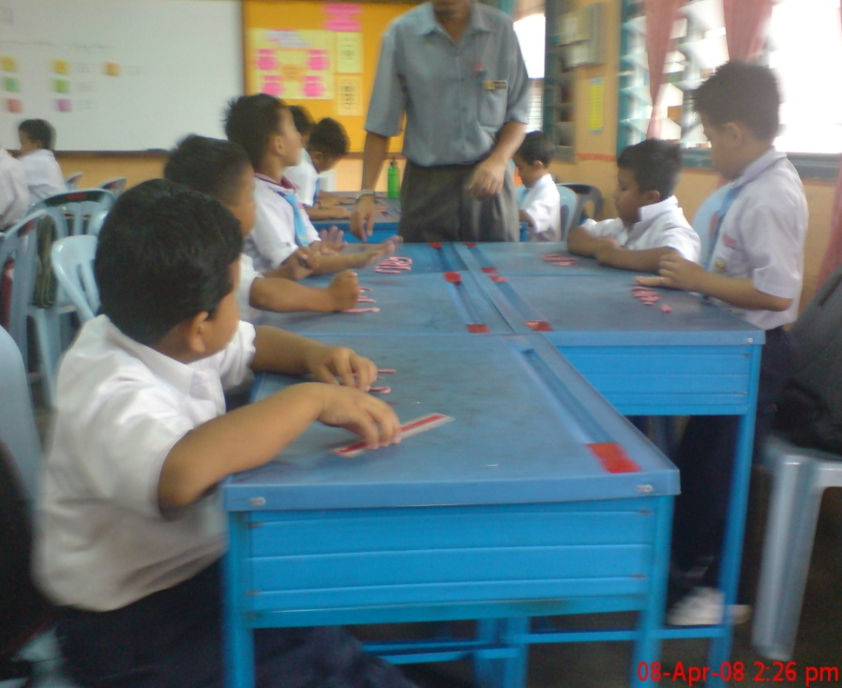
WRITING
3.3 Pupils will be able to write and present ideas through a variety of media.
3.3.1 Able to create simple non-linear texts using a variety of media with
guidance:
(a) posters
(b) signs

Slide 23
LANGUAGE ARTS
4.1 Pupils will be able to enjoy and appreciate rhymes, poems and songs
through performance.
4.1.1 Able to listen to and enjoy nursery rhymes, jazz chants and action songs
through non-verbal response.
4.1.2 Able to listen to and recite nursery rhymes, jazz chants and sing action
songs with correct pronunciation and rhythm.
4.2 Pupils will be able to demonstrate understanding of and express
personal response to literary texts.
4.2.1 Able to listen to and talk about stories with guidance:
(a) book covers
(b) pictures in books

Slide 24
LANGUAGE ARTS
4.3 Pupils will be able to plan, organize and produce creative works for
enjoyment.
4.3.1 Able to produce simple creative works with guidance based on:
(a) action songs
(b) jazz chants
(c) stories
4.3.2 Able to take part with guidance in a performance based on:
(a) action songs
(b) jazz chants
(c) stories

Slide 25
GRAMMAR
5.1 Pupils will be able to use different word classes correctly and appropriately.
5.1.1 Able to use nouns correctly and appropriately:
(a) common nouns
(b) proper nouns
(c) singular nouns
(d) plural nouns
5.2 Pupils will be able to construct various sentence types correctly.
5.1.2 Able to construct declarative sentences correctly.

Slide 26
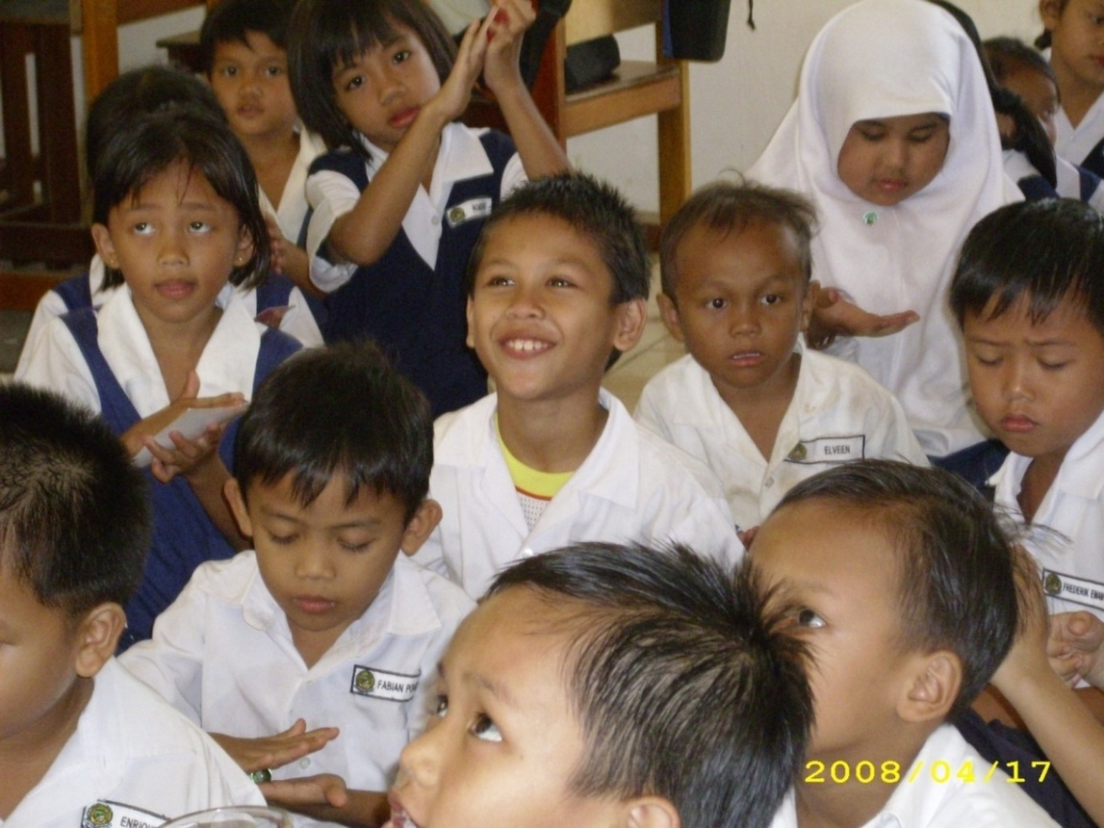
http://www.moe.gov.my/bpk/
THANK YOU

